Slide 1
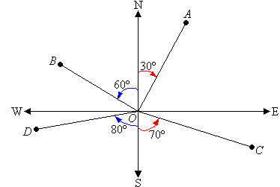
24
7
30
Date
Trigonometry
EQ – What are Bearings
The direction to a point is stated as the number of
degrees east or west of north or south.
For example, the direction of A from O is N30ºE. B is N60ºW from O. C is S70ºE from O. D is S80ºW from O.
Note:
N30ºE means the direction is 30º east of north.
5
Notes:
Input

Slide 2
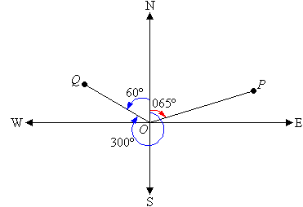
24
7
30
Date
Trigonometry
EQ – What are Bearings
The bearing to a point is the angle measured in a
clockwise direction from the north line.
For example, the bearing of P from O is 065º. The bearing of Q from O is 300º.
5
Notes:
Input

Slide 3
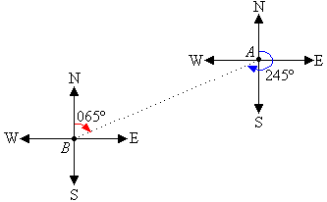
24
7
30
Date
Trigonometry
EQ – What are Bearings
A bearing is used to represent the direction of one point
relative to another point.
For example, the bearing of A from B is 065º. The bearing of B from A is 245º.
Three figures are used to give bearings.
All bearings are measured in a horizontal plane.
5
Notes:
Input

Slide 4
Practice
Lable the axis with N; S; E; W; NE; NW; SE; SW.
On what bearing is a ship sailing if it is heading: (a) E, (b) S, (c) W, (d) SE, (e) NW ?

Slide 5
Essential Mathematics – Units 3 and 4
Page 76 – Questions 1 & 2

Slide 6
Check for understanding
Close your books
On the A5 sheet of paper write as many features about bearings that you can remember. (you can also use a diagram)
Compare what you have written with the person next to you
Thumbs up if the person next to you ‘has got it’ Thumbs to the side if they are ‘almost there’ Thumbs down if the have ‘no clue’
Notes:
Check for understanding

Slide 7
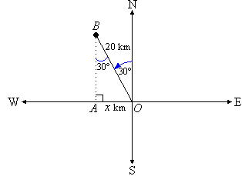
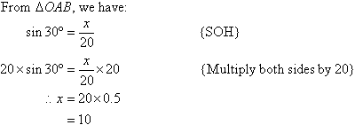
24
7
30
Date
Trigonometry
EQ – How do bearings and trigonometry work together.
A boat sails from a certain port in the direction N30ºW. After the boat has sailed 20 km, how far is it west of the port?
Let the boat be x km west of the port.
So, the boat is 10 km west of the port.
5
Notes:
Input

Slide 8
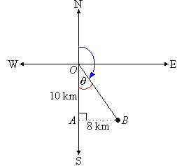
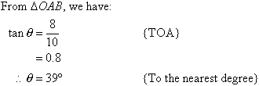

24
7
30
Date
Trigonometry
EQ – Bearings
A cyclist travels 10 km south, then 8 km east. Find the cyclist's bearing from her starting point to the nearest degree.
So, the cyclist's bearing is 141º from her starting point.
5
Notes:
Input

Slide 9
Activity
Essentials Mathematics – Units 3 and 4 Pages 76 & 77 Questions 3 to 7
Notes:
Independent practice

Slide 10
Closure activity
Notes:
Closure

